Slide 1
BUILD APPS THAT DON’T FAIL IN PRODUCTION
GARRY TRINDER
DEVELOPER ADVOCATE, MICROSOFT
MICROSOFT 365, COPILOT AND DEV PROXY

Slide 2




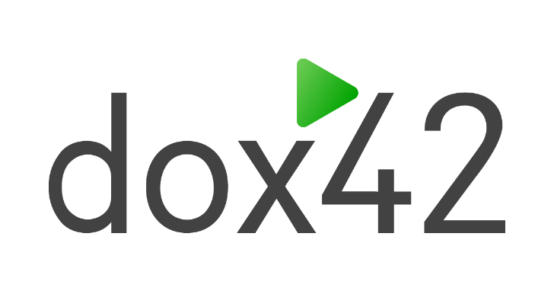

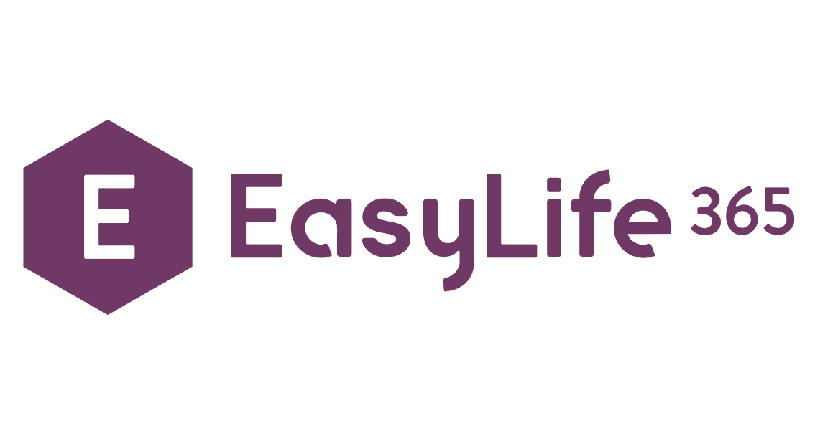









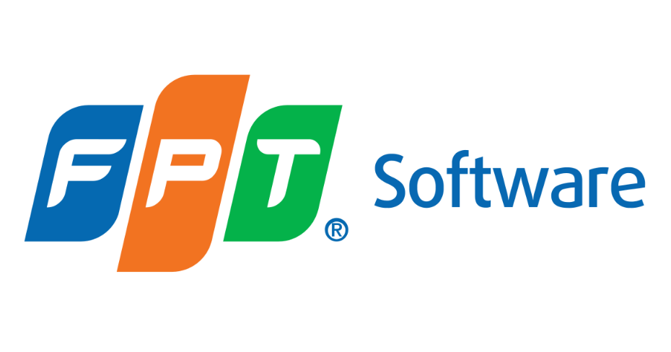








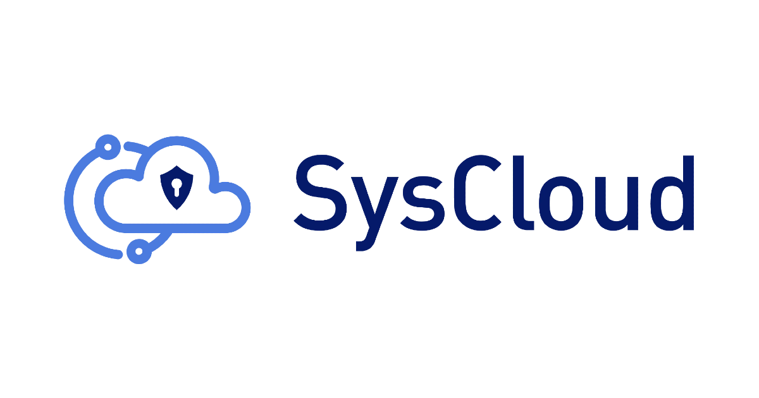
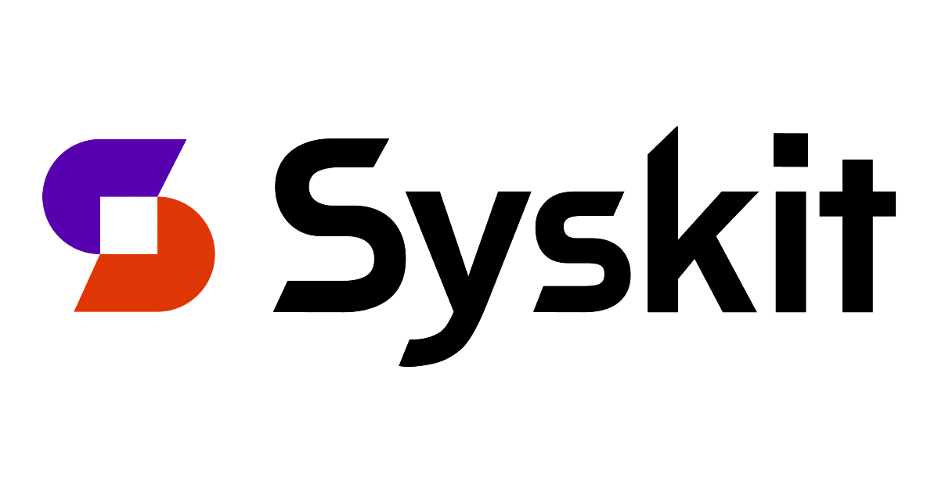


Slide 3


Slide 4
What we will cover today 📃
Audience: Developer, Tester, Administrator 🧑‍💻
What are ‘resilient’ apps? 💪
Why building resilient apps is hard 🤯
How Dev Proxy makes life easier 🧘
Learn how to get started 🧑‍🏫

Slide 5
What are ‘resilient’ apps? 💪
An app is resilient if it
continues to carry out its mission in the face of adversity ▶️
As in the old Timex commercial
"can take a licking and keep on ticking.” ⌚
System Resilience: What Exactly is it? (cmu.edu) – Donald Firesmith

Slide 6
What is ‘resilience’ ?💪
Resilience assumes that adverse conditions will occur 🌩️
Resilience is not a tick box ✅
Resilience is a combination of
Availability, capacity, interoperability, performance, reliability, robustness, safety, security and usability
Availability and reliability by themselves are insufficient

Slide 7
Cloud APIs fail ❌
It’s not a matter of if, it’s when
How do you know what is going to happen?
How will your app recover? Will it recover?
How do you test for failures?

Slide 8
Testing cloud APIs is hard 🧪
You don’t own the APIs
You can’t turn just turn behaviours on and off 🔘
Hard to get started
Nobody pays for testing 💵
Each API is different
Some return 429s, others 403s, some return several 429s

Slide 9

Dev Proxy
Helps you build resilient apps on Microsoft 365
Improve robustness, performance and security
Test the untestable
Run against any app
Any platform and any tech stack
Supports any HTTP API
Presets for Microsoft Graph and SharePoint Online
Low investment (effort and time)
No code changes, no tedious setup
aka.ms/devproxy

Slide 10
Improve robustness 💪
“the ability to withstand or overcome adverse conditions”
“reveal issues to you before they affect your users”
Random errors
What happens when APIs fail?
Latency
What happens when APIs are slow?
Throttling and Rate Limiting
What happens when APIs throttle?
Notes:
Random errors
Start proxy with defaults, accept certificate
PS web request = Invoke-WebRequest -Uri "https://graph.microsoft.com/v1.0/me“
Show the output in the console, was the request passed through or did proxy inject some chaos, repeat until we see chaos
Show m365proxyrc file, walk through the configuration and plugin architecture, watch URLs
Show specifically the GraphRandomErrorPlugin, the config section and the rate.
Stop proxy -> Ctrl + C (explain the importance of this, needs to be done to de-register the system proxy)
Explain how we can override the default settings m365proxy --failure-rate 70 --allowed-errors 429
Test throttling in Graph Explorer
Graph Explorer = my profile
Throttling
Graph Explorer =
Rate-Limiting curl github API preset, use the gallery

Slide 11
Improve performance 🏎️
“the ability to respond efficiently to user requests,
whilst using minimum resources”
$select guidance
Are you only returning the data that you need?
Caching guidance
Are you sending the same requests in a short period?

Slide 12
Improve security 🔐
“ensure the principle of least privilege”
Detect minimum required permissions
Are you using the right scopes?
Detect over consented applications
Is your app obtaining more permissions than it needs?
Notes:
During development its sometimes easier to grant higher consented scopes, Group.ReadWrite.All

Slide 13
Any questions? 🙋
Thank you for listening ❤️
aka.ms/devproxy

Slide 14

THANK YOU, YOU ARE AWESOME ❤️
PLEASE RATE THIS SESSION IN THE MOBILE APP.
@GARRYTRINDER

